Slide 1
Elements and Compounds
Chapter 3

Slide 2
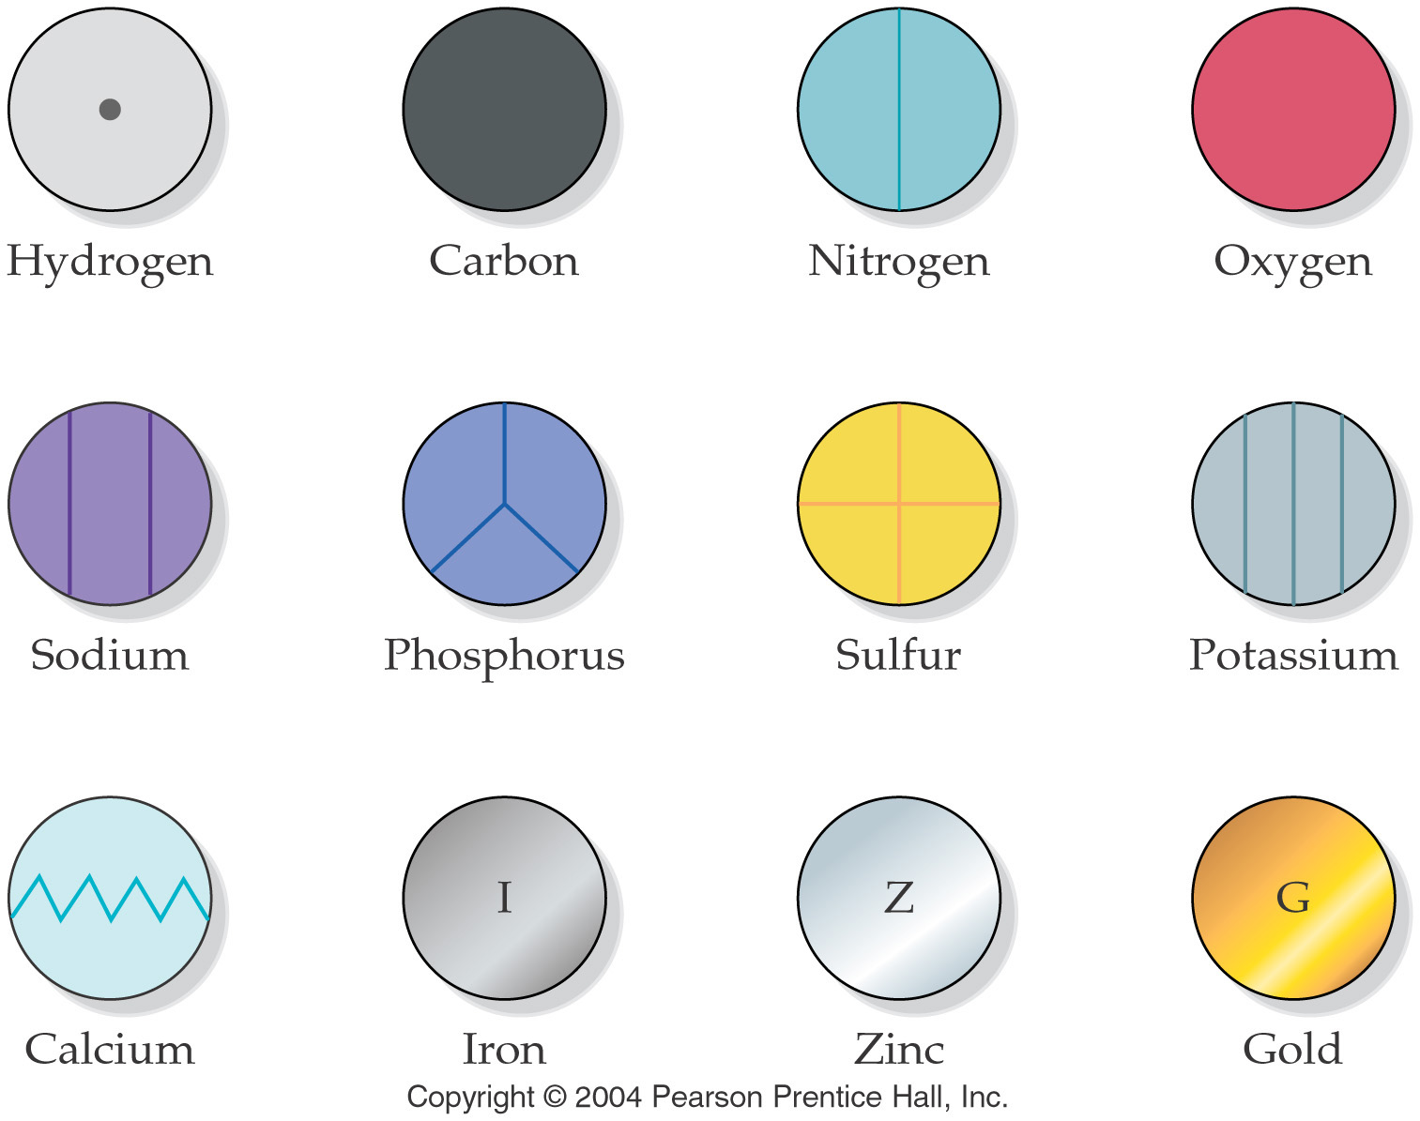
Dalton’s symbols for elements

Slide 3
Element Names and Symbols
Element Ele
name symbol
1 or 2 letters (occasionally 3)
1st letter is capitalized, 2nd letter is lower case.

Slide 5
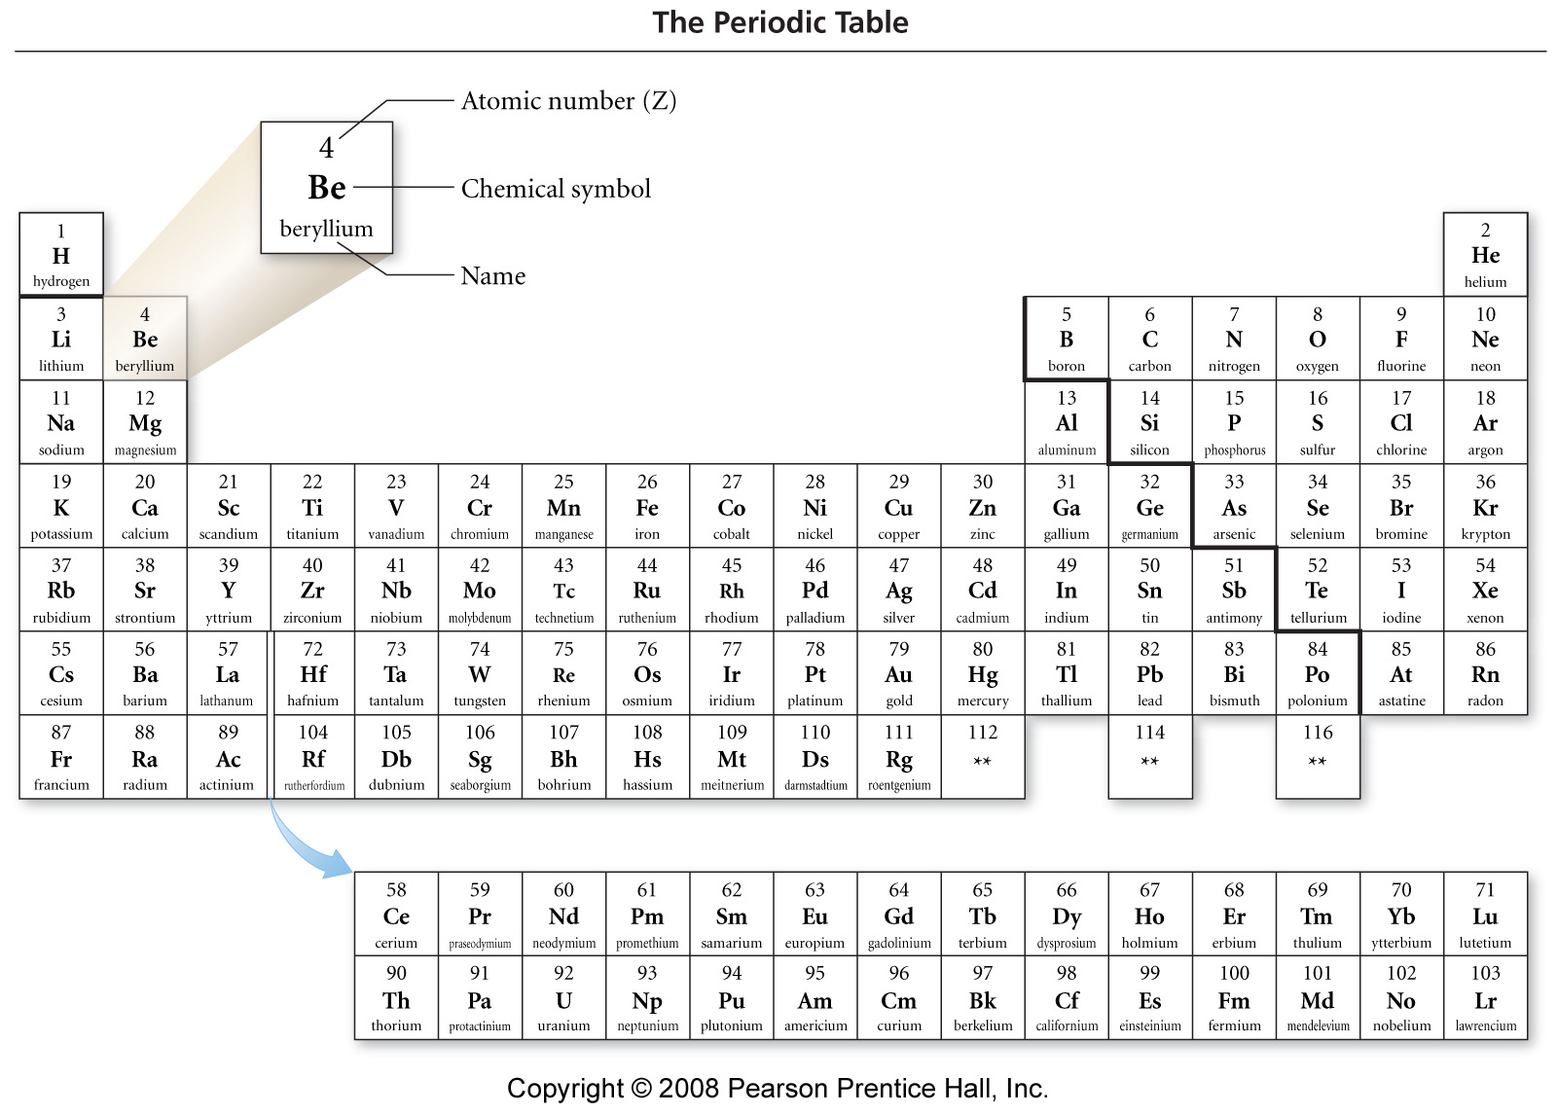
Notes:
Figure: 02-09
Title:
The Periodic Table
Caption:
Each element is represented by its symbol and atomic number. Elements in the same column have similar properties.

Slide 6
Nomenclature
Learn the names and symbols of the elements.
You must know 1st 36 elements + Rb, Sr, Cs, Ba, Ra, Zr, Ag, Cd, Sn, Sb, Te, I, Xe, Pt, Au, Hg, Pb, Bi, Rn, U

Slide 7
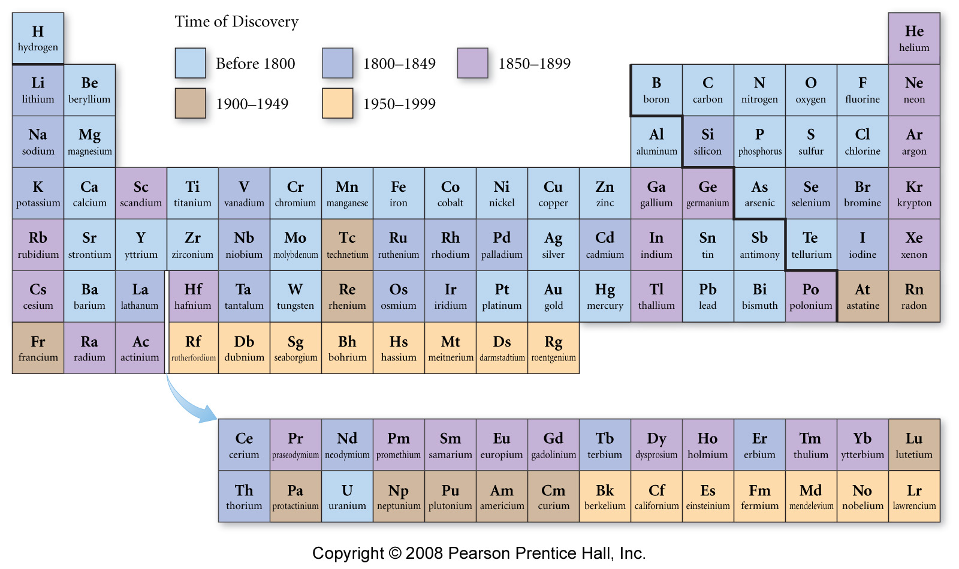
Notes:
Figure: 02-09-05UN
Title:
Time of Discovery Periodic Table
Caption:
Many of the elements that we know today were discovered during Mendeleev's lifetime.

Slide 8
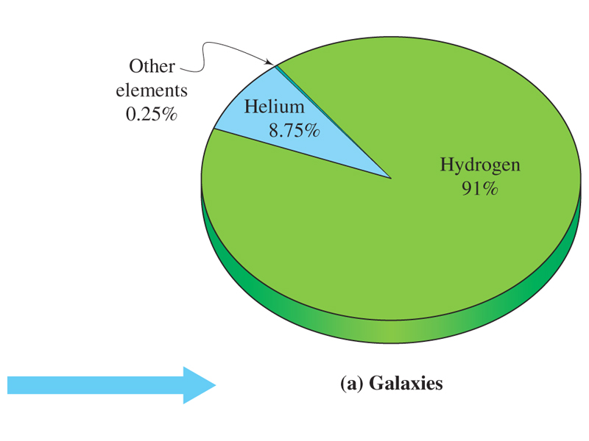
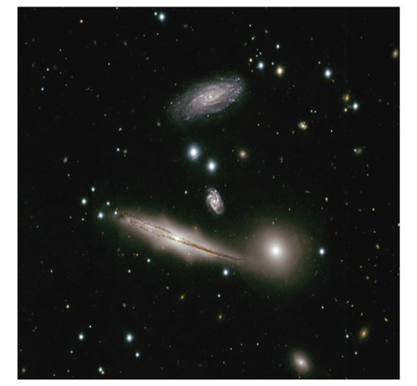
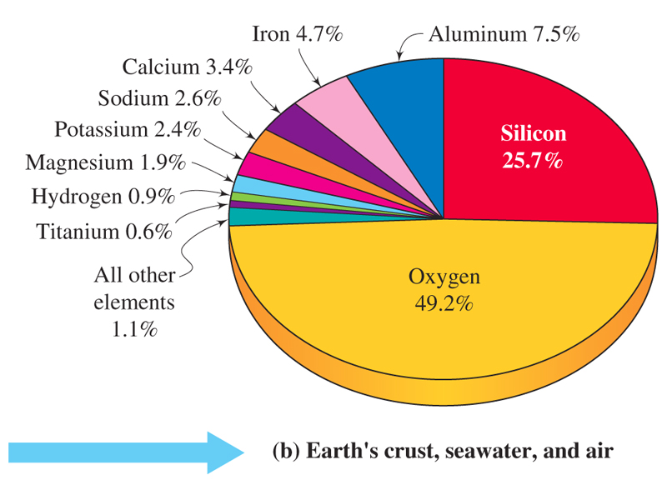
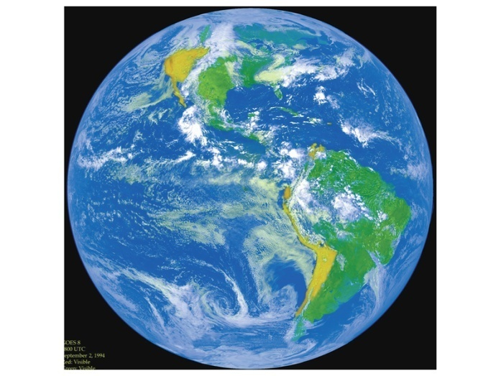
Distribution of the common elements in nature.
3.2

Slide 9
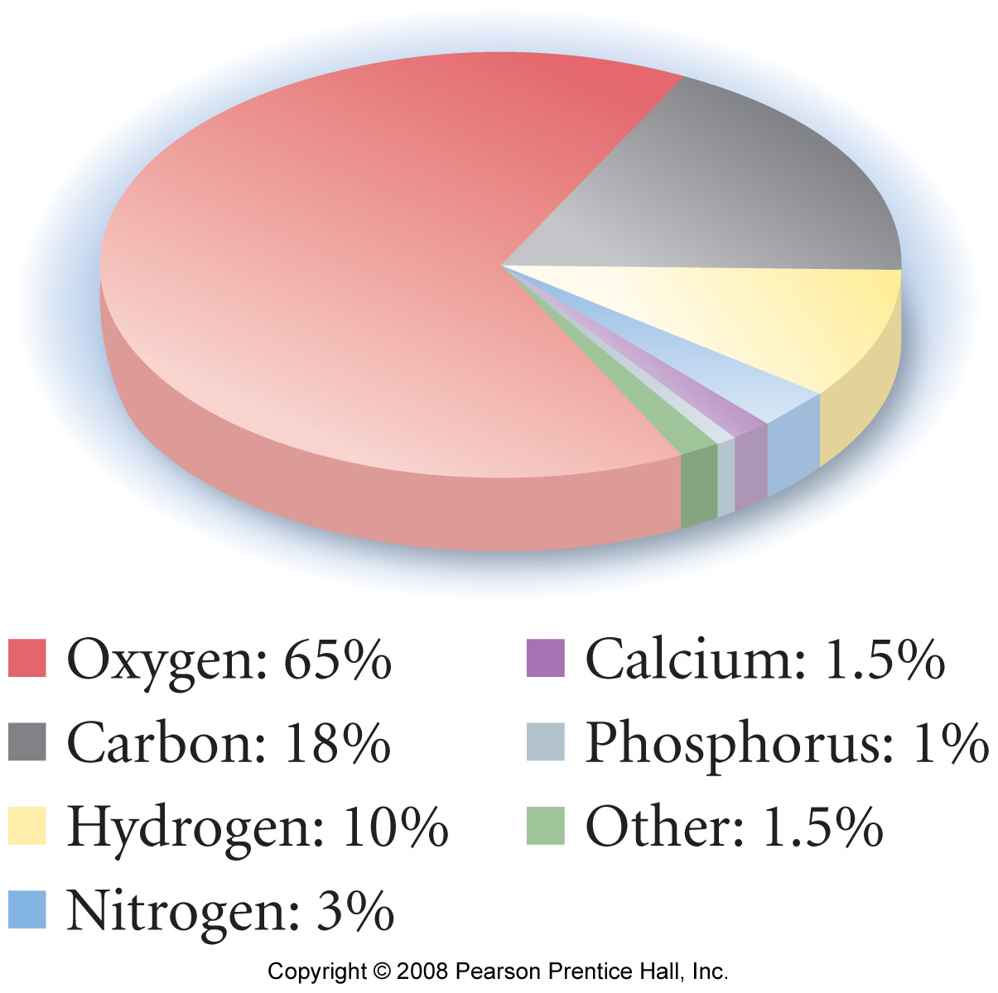
Elemental Composition of Humans (by mass)
Notes:
Figure: 02-15
Title:
Elemental Composition of Humans (by Mass)
Caption:
By mass, our bodies are mostly oxygen atoms because of the large amount of water in our bodies. Carbon comes in second and hydrogen third.

Slide 10
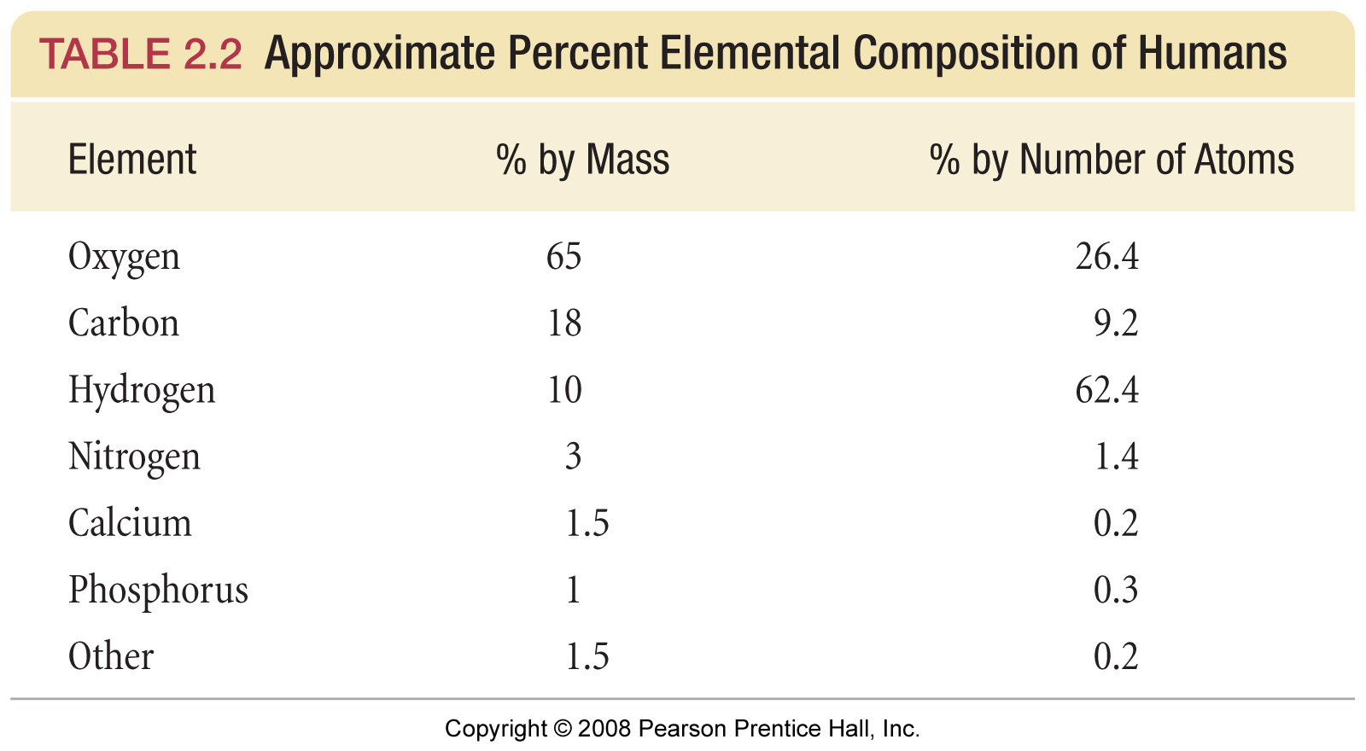
Notes:
Figure: 02-T02
Title:
TABLE 2.2 Approximate Percent Elemental Composition of Humans
Caption:
By mass, our bodies are mostly oxygen atoms because of the large amount of water in our bodies. Carbon comes in second and hydrogen third.

Slide 11
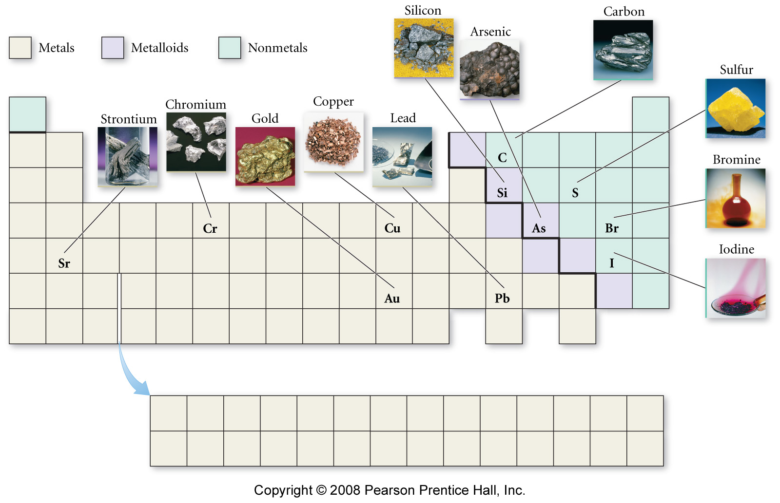
Notes:
Figure: 02-12-01UN
Title:
Some representative metals, metalloids, and nonmetals
Caption:
Commonly-encountered elements are found throughout the periodic table.

Slide 12
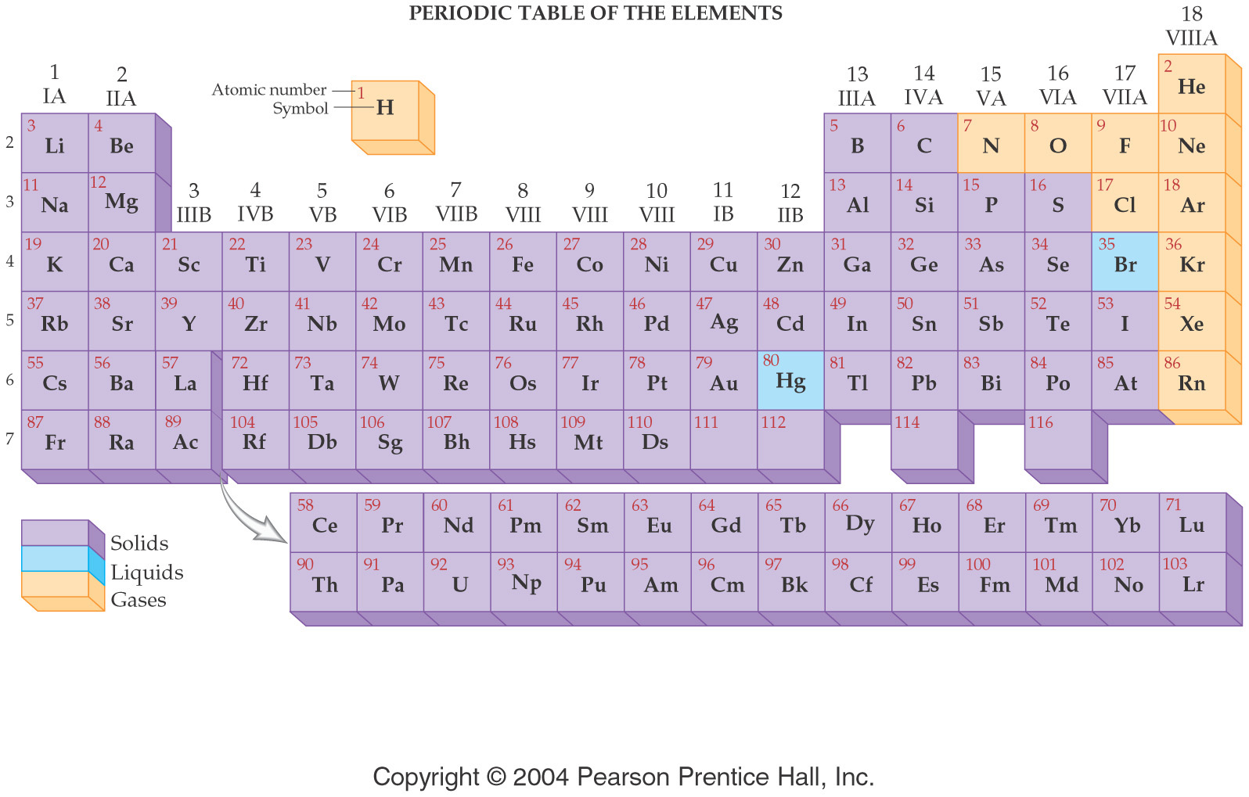

Slide 13
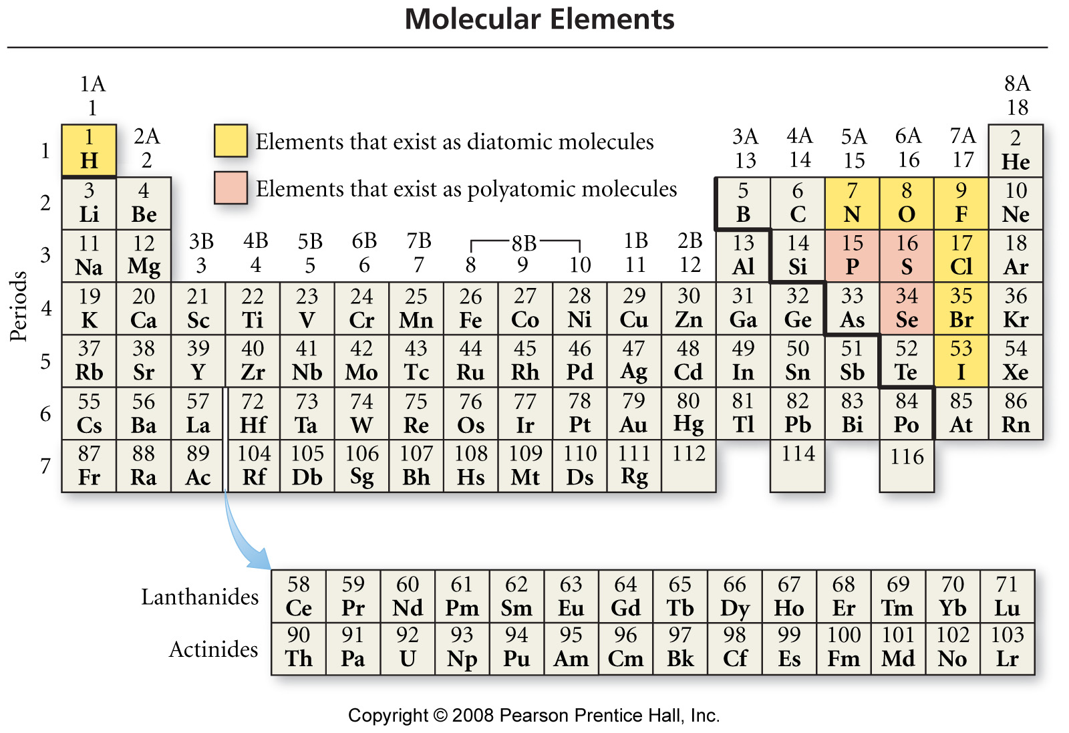
Notes:
Figure: 03-04
Title:
Molecular Elements
Caption:
The highlighted elements exist primarily as diatomic molecules (yellow) or polyatomic molecules (red).

Slide 14
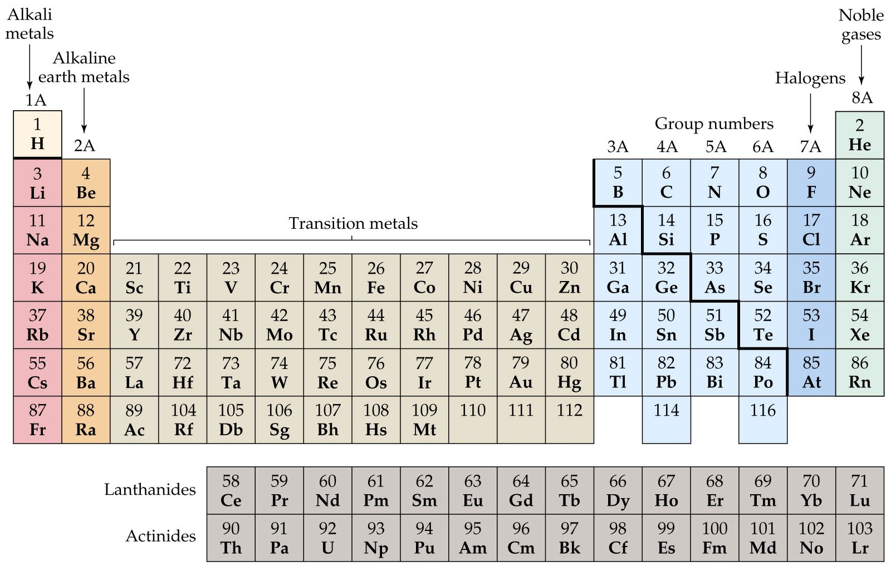

Slide 15
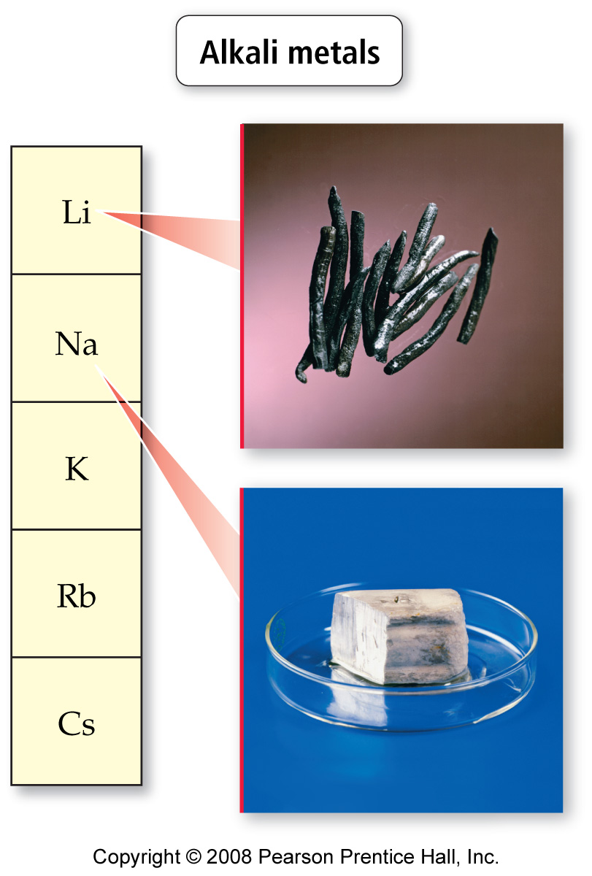
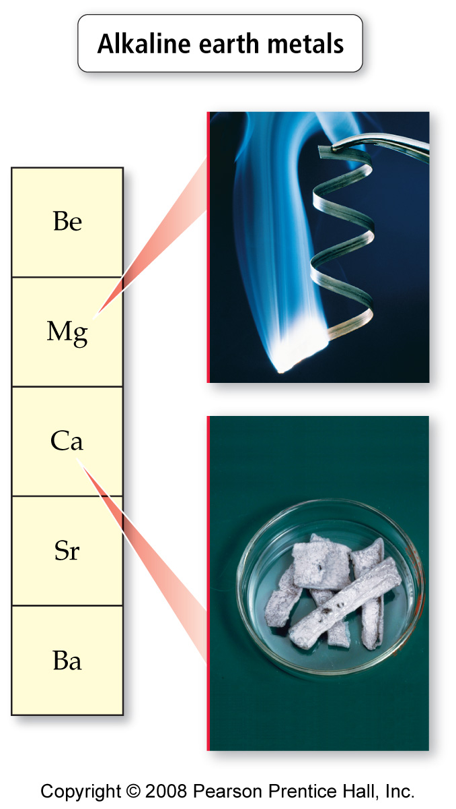
Notes:
Figure: 02-13-01
Title:
Noble gases
Caption:
The noble gases get their group name from their reluctance to react with other elements.

Slide 16
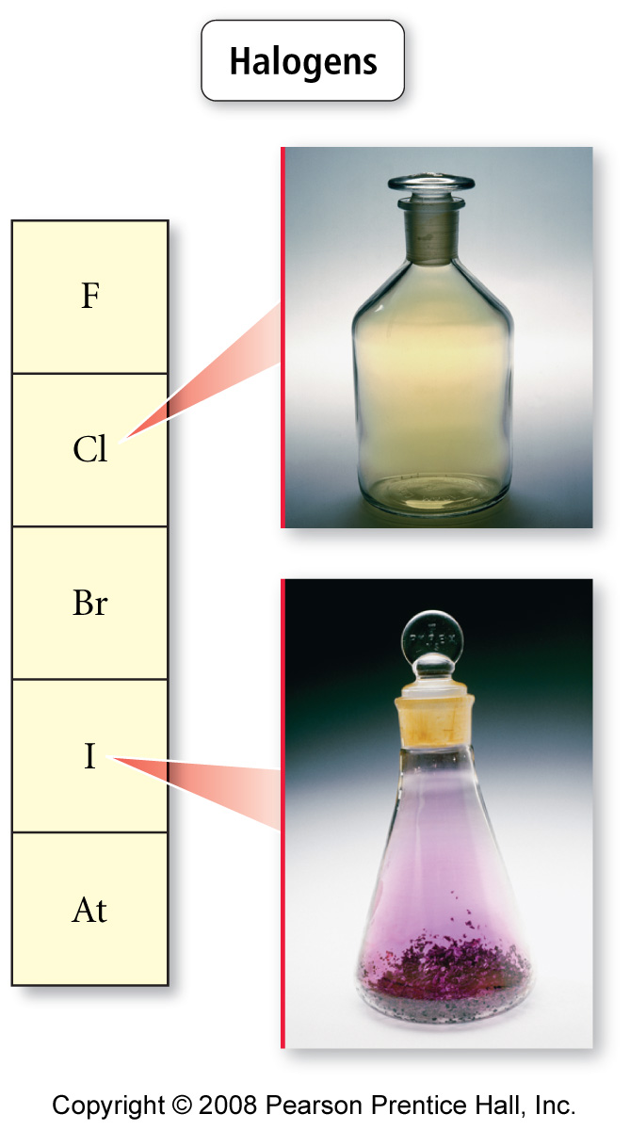
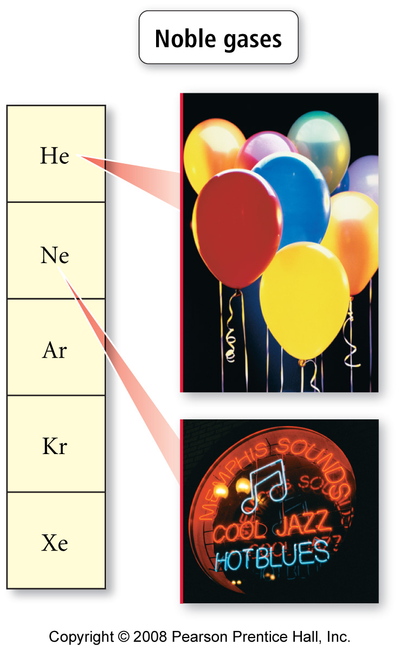
Notes:
Figure: 02-13-04
Title:
Halogens
Caption:
Halogens are reactive nonmetals.

Slide 17
Metallic characters
Metal – shiny, high density, high melting point, great conductor of heat and electricity
Non-metal – dull, low density, low melting point, not good conductor of heat and electricity
Semi-metal – metal-like in appearance and has properties that are between that of a metal and a non-metal.

Slide 18
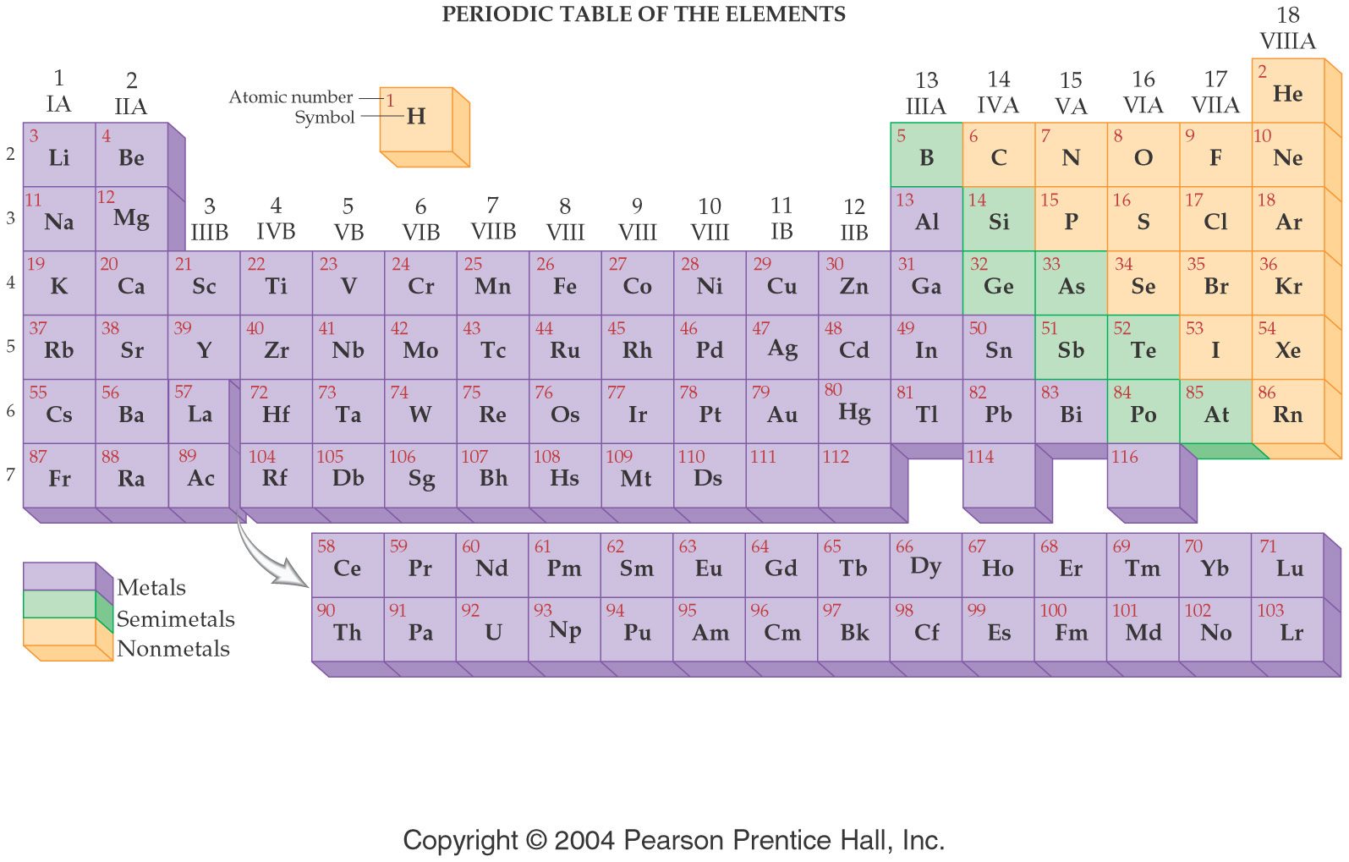

Slide 19
Chemical Formulas
AxByCz
Elemental Symbol
Number of atoms

Slide 22
Law of Constant Composition
The law of constant composition states that the composition of a substance is always the same, regardless of how the substance was made or where the substance is found.
For example
All water is 11.3% H and 88.8% O

Slide 23
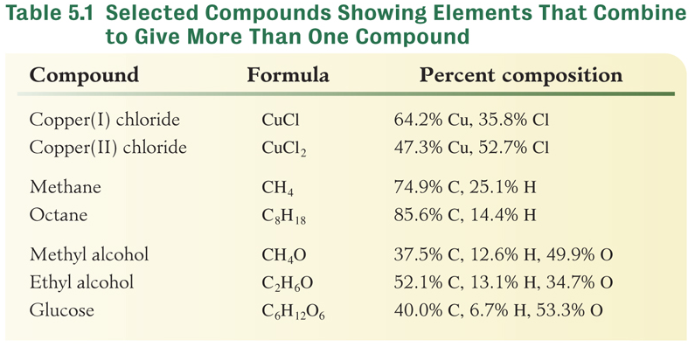
Law of Multiple Proportions
If the same two elements(A and B) formed two different compounds, there is a whole number relationship between the masses of B in the two different compounds for each gram of A in the compound.
CO 12 g C 16 g O
CO₂ 12 g C 32 g O

